Slide 1
Summer Work
Aristos Athens – Majumdar Lab

Slide 2

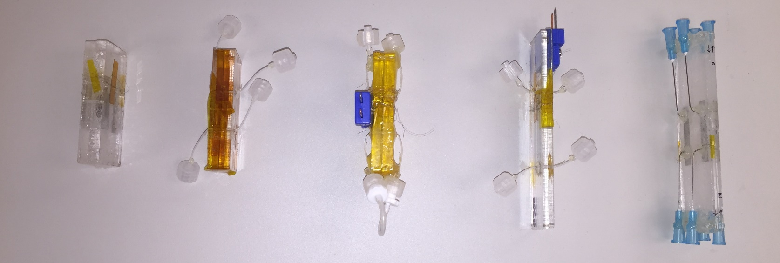
HX Progression
1/2

Slide 3
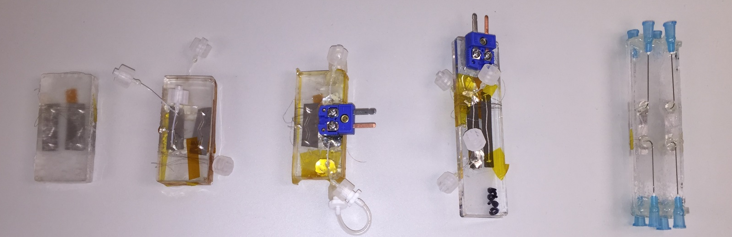
HX Progression
2/2

Slide 4
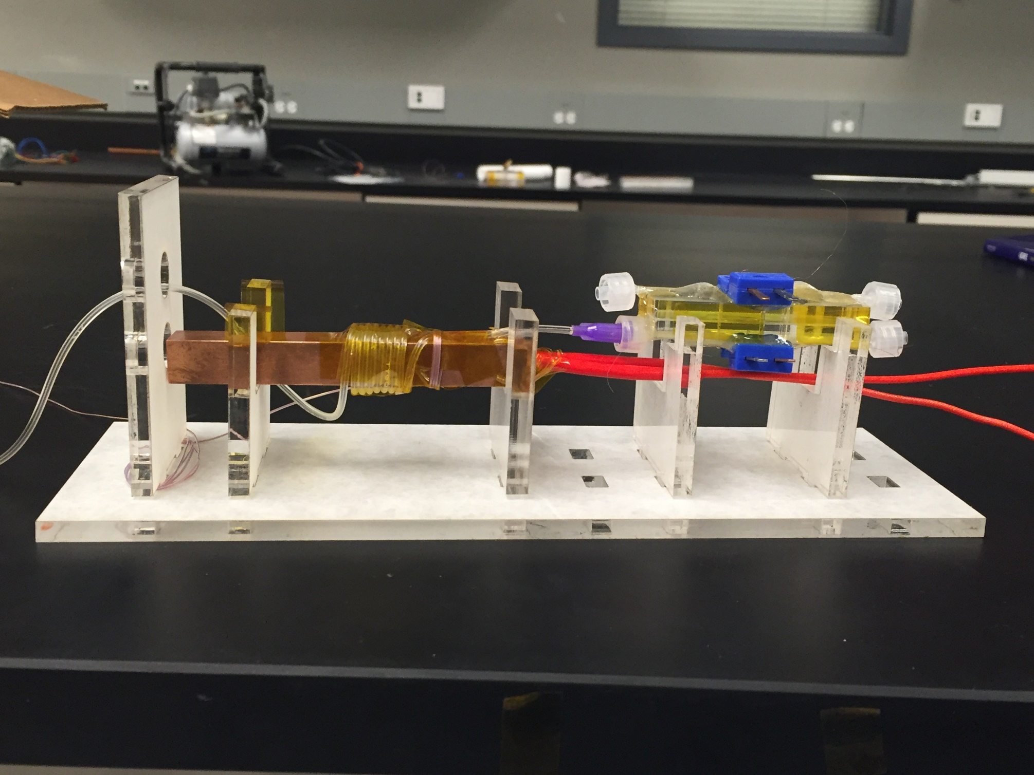
Current Set-up
1/3

Slide 5
Current Set-up
2/3

Slide 6
Current Set-up
3/3

Slide 7
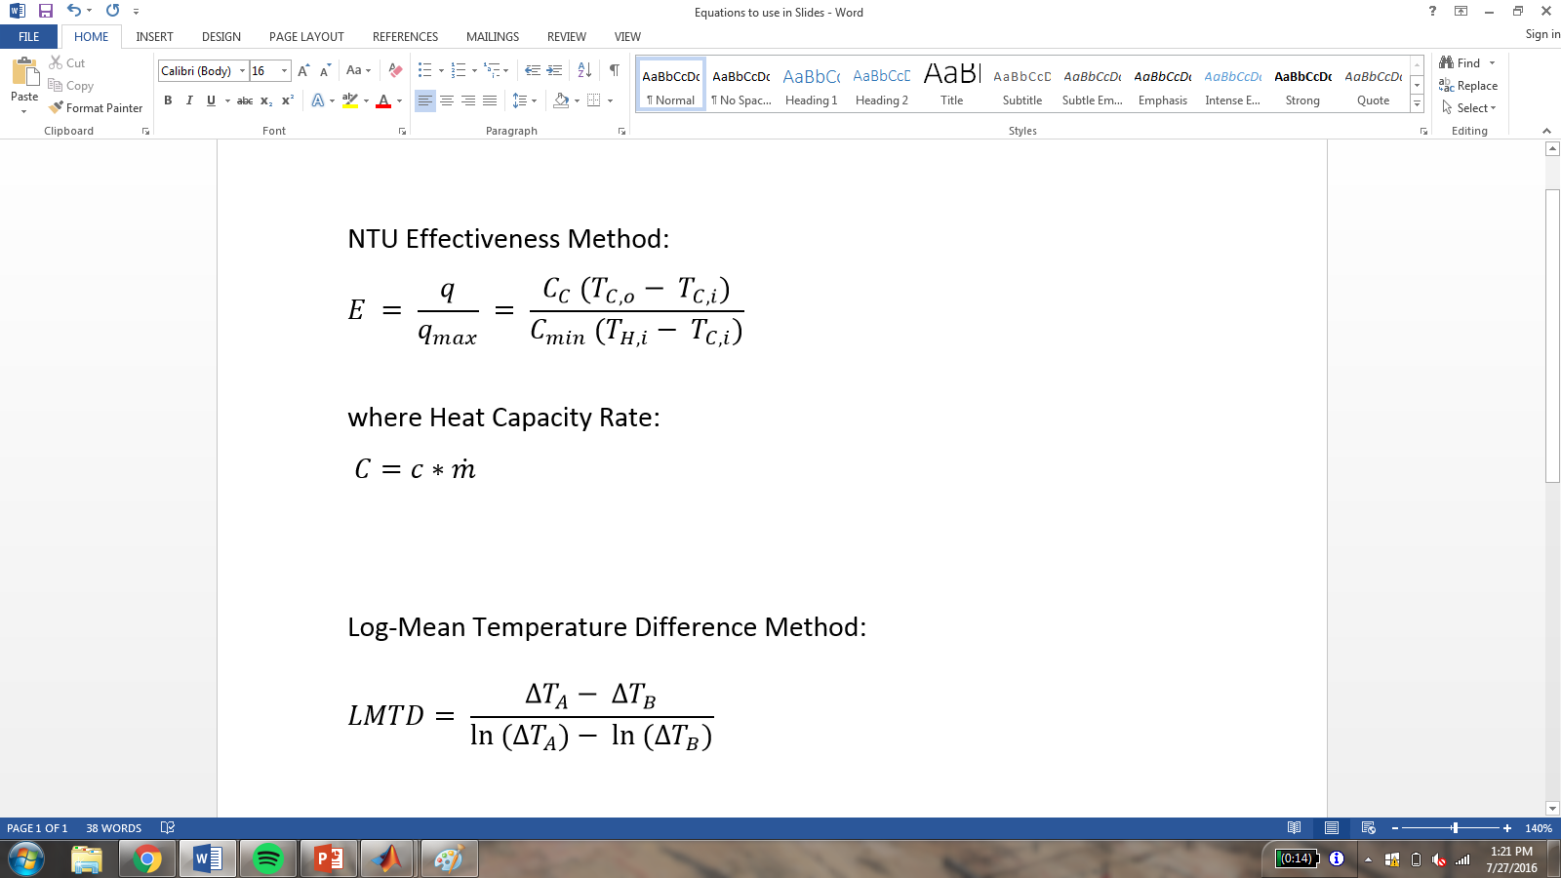
1/3

Slide 8
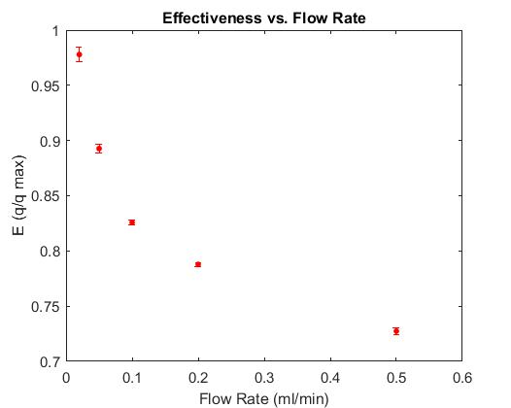
2/3

Slide 9
3/3

Slide 10
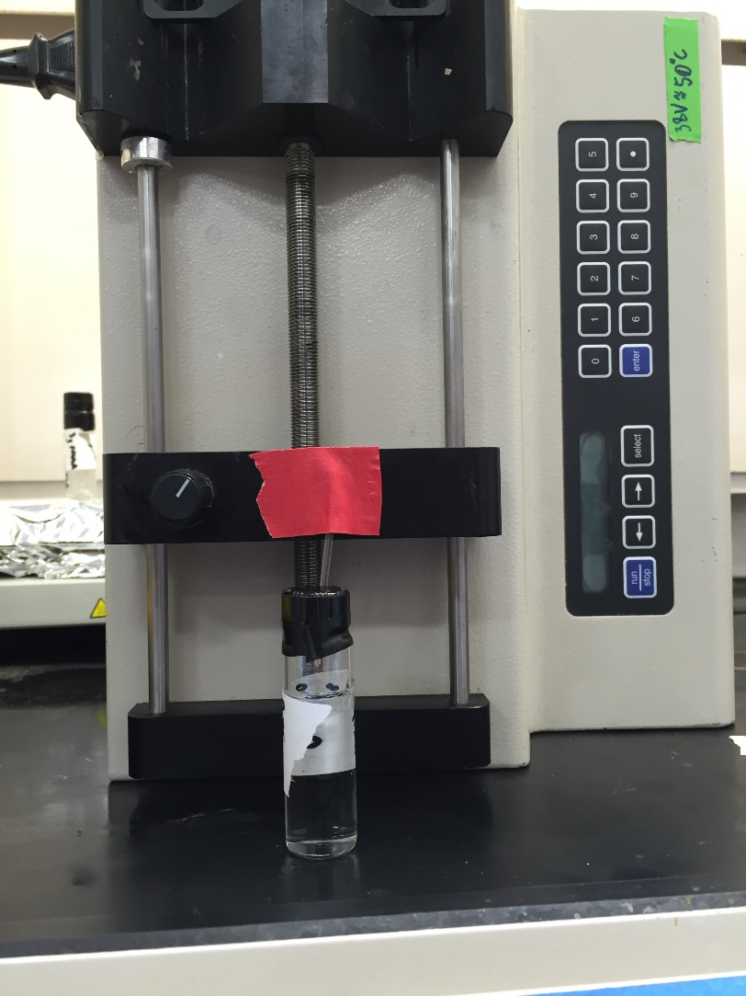
Coating Thermocouples
Protection from acidic corrosion
Polymer: Something flexible when dry
Suggestions?
1/2

Slide 11
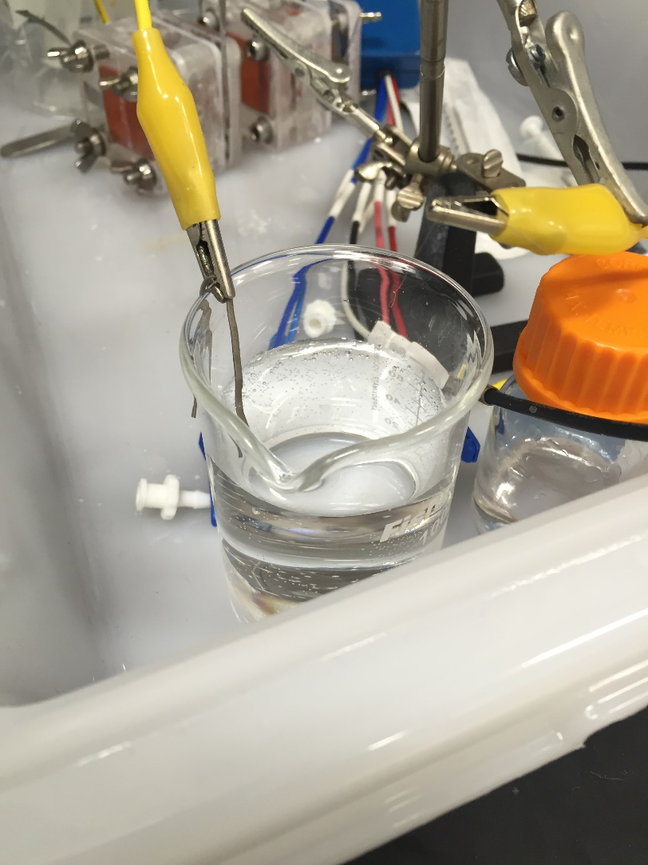
Coating Thermocouples
Protection from acidic corrosion
Polymer: Something flexible when dry
Suggestions?
2/2

Slide 12
Further Work
HX
Insulation
Inlet heaters
TC coating
Training
Dip coating
Spin coating
SEM

Slide 13
Personal Background
1/5

Slide 14
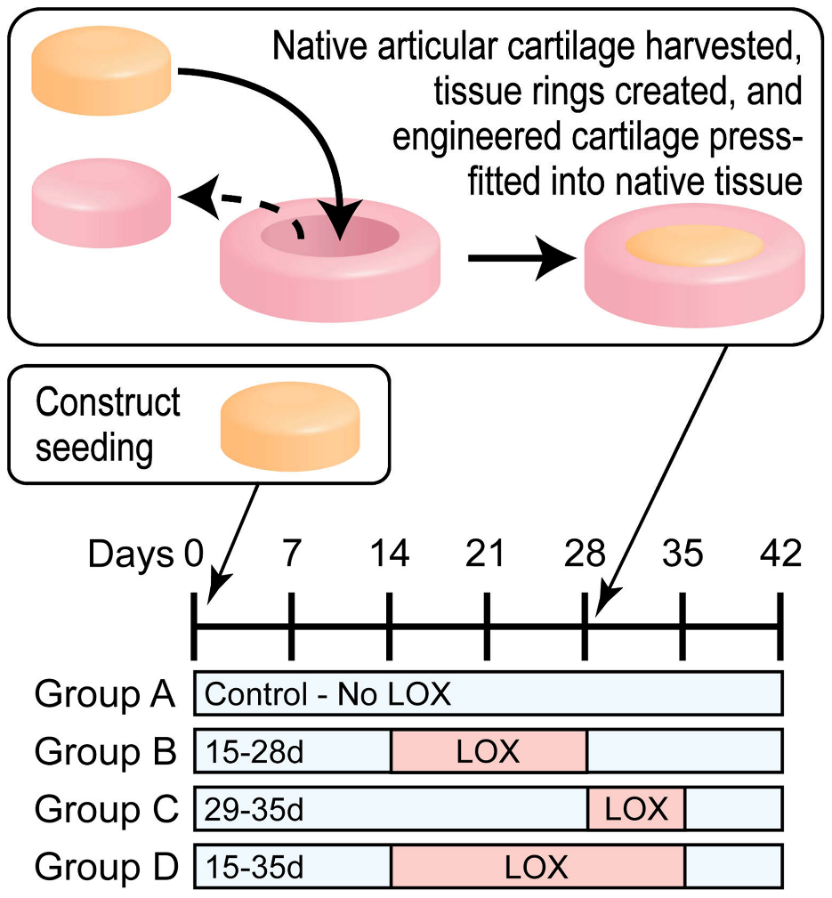
Personal Background – Previous Work
Bioengineering Research
Publication: Induced Collagen Cross-Links Enhance Cartilage Integration (Athens, Makris, Hu)
2/5

Slide 15
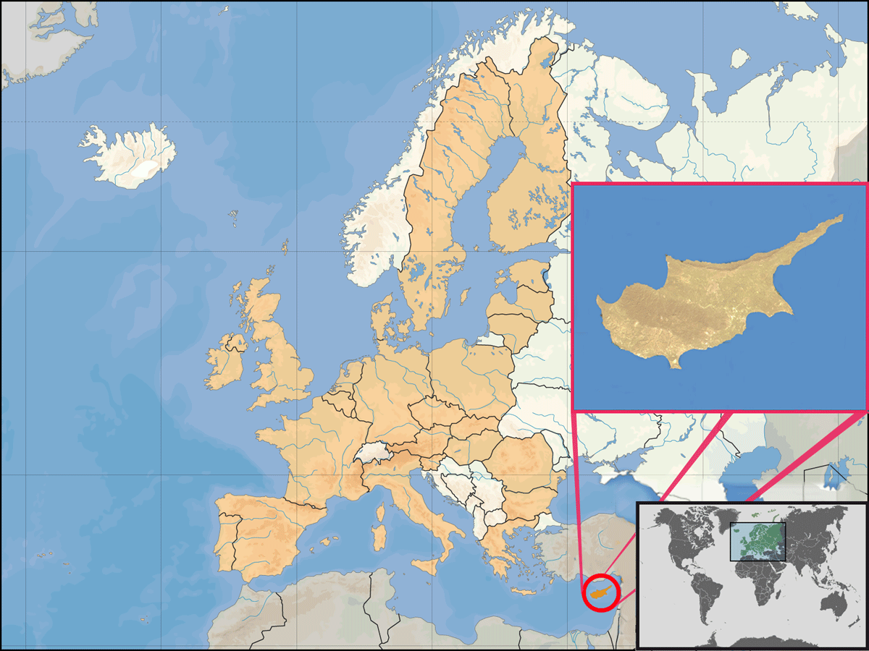
Personal Background
3/5

Slide 16
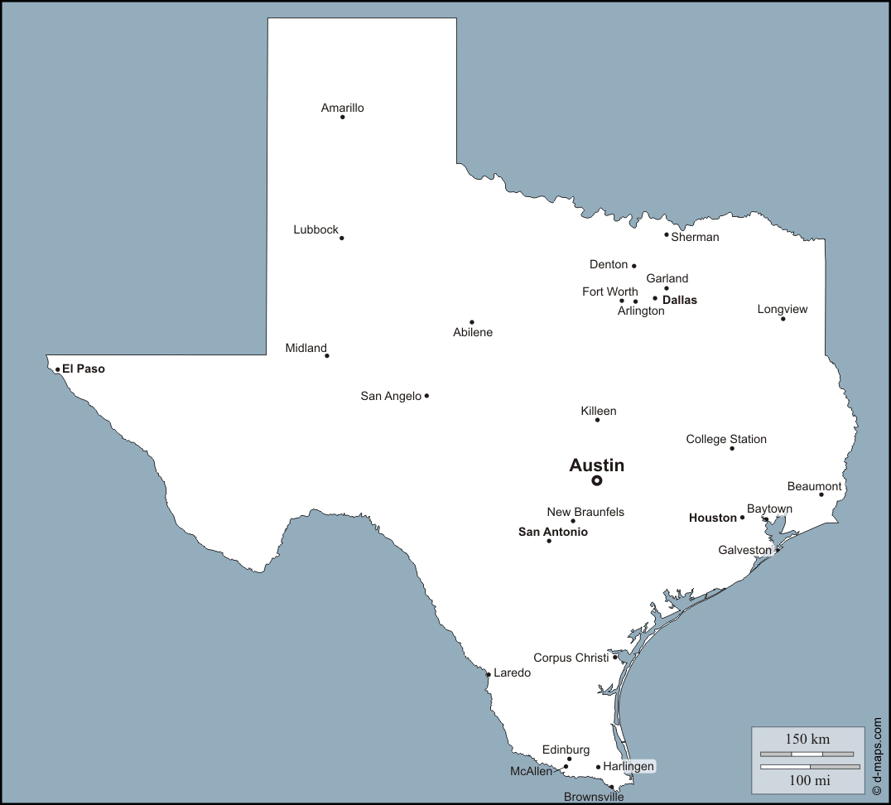
Personal Background
4/5

Slide 17
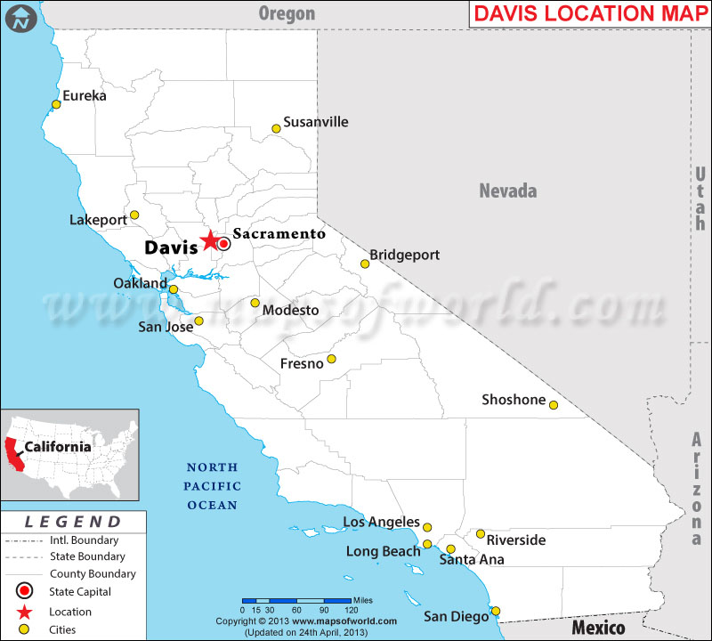
Personal Background
5/5

Slide 18
END

Slide 19
Extra Slides

Slide 20
Quick Calculations/Numbers

Slide 21
Rough Values
Acrylic, k = 0.2 (W/m*K)
Titanium, k = 6-25 (W/m*K), use 15
Low velocity forced convection (water), h = 50-2000 (W/m^2*K), , use 500

Slide 22
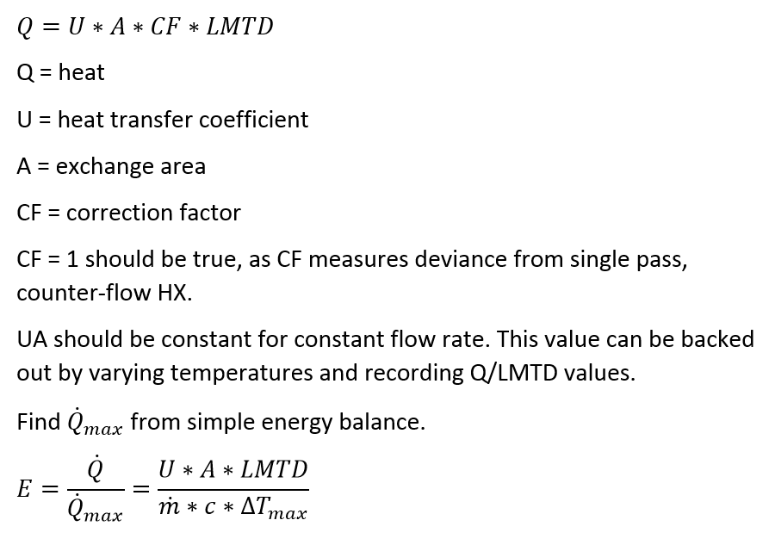

Slide 23
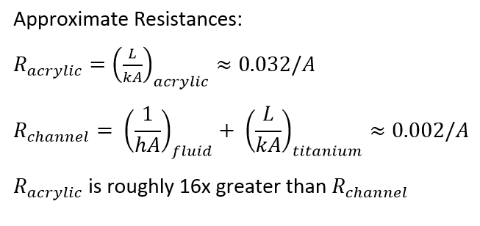
Can we ignore heat loss through acrylic?

Slide 24
Current Set-up Data

Slide 25
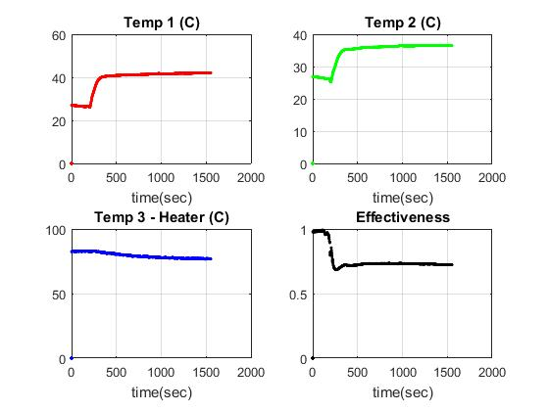
Data (0.5 ml/min)

Slide 26
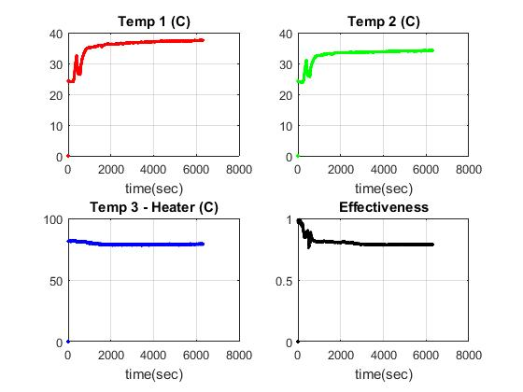
Data (0.2 ml/min)

Slide 27
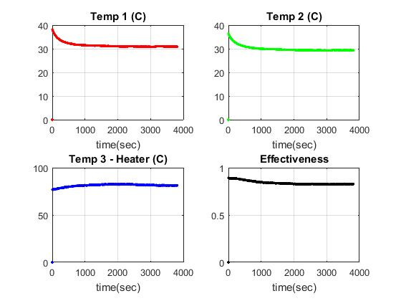
Data (0.1 ml/min)

Slide 28
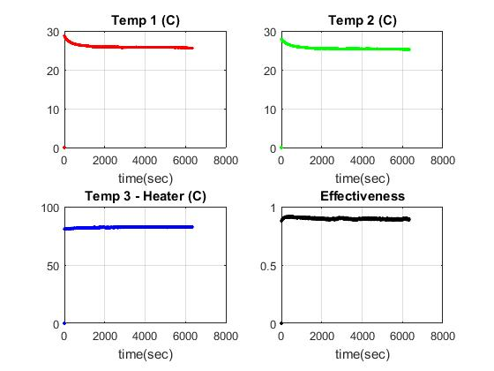
Data (.05 ml/min)

Slide 29
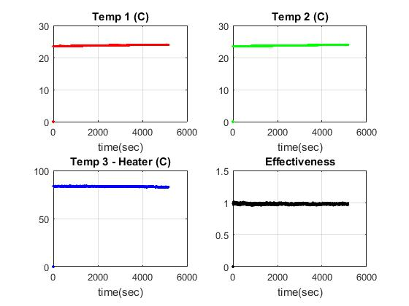
Data (.02 ml/min)

Slide 30
HX Design and Fabrication

Slide 31
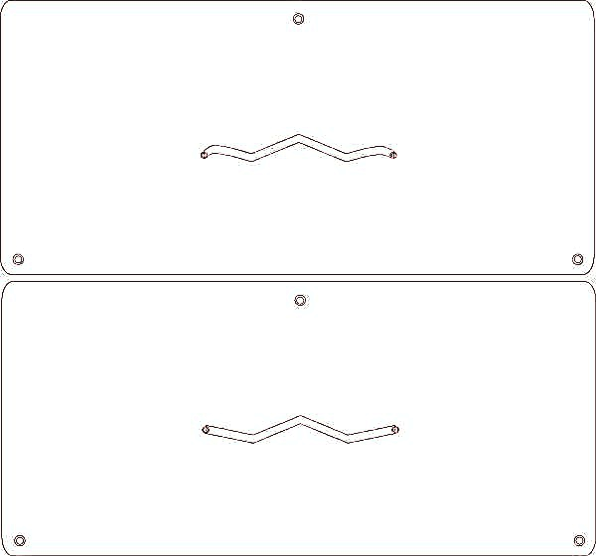
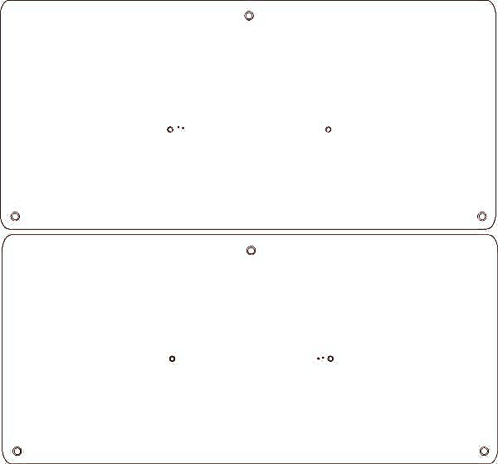
HX Channel Design (Laser Cut)

Slide 32
Previous Testing Set-Up

Slide 33
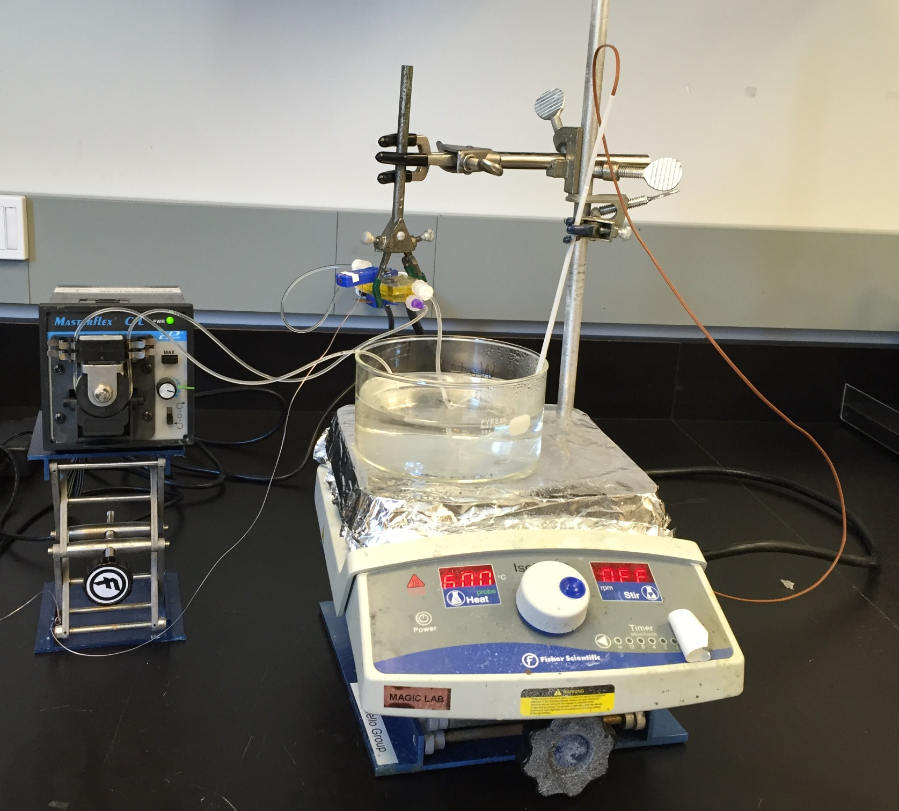
Original Set-up

Slide 34
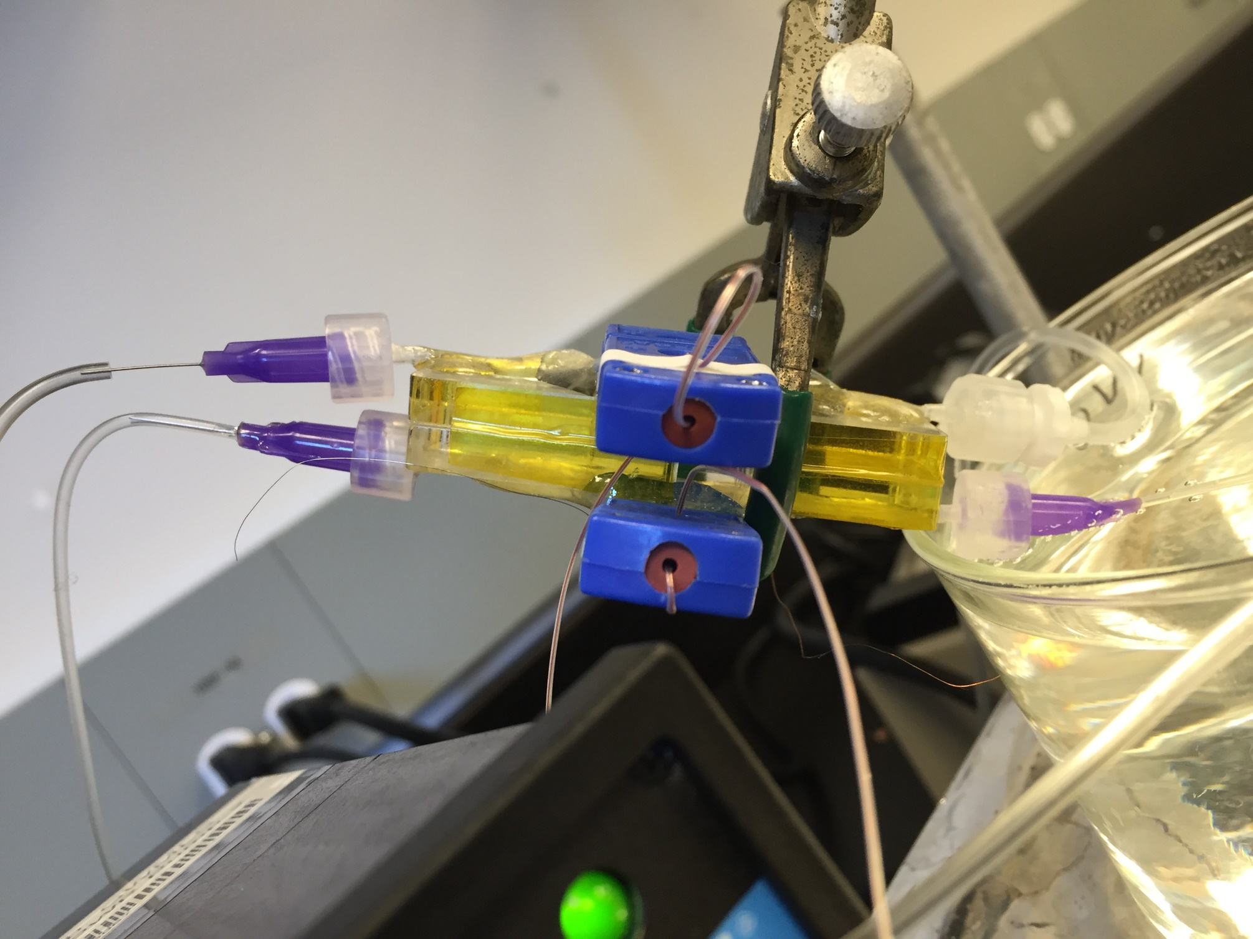
Original Set-up

Slide 35
Original Set-up

Slide 36
Original Set-up

Slide 37
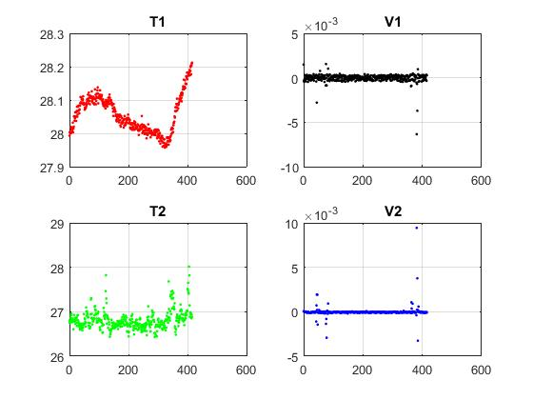
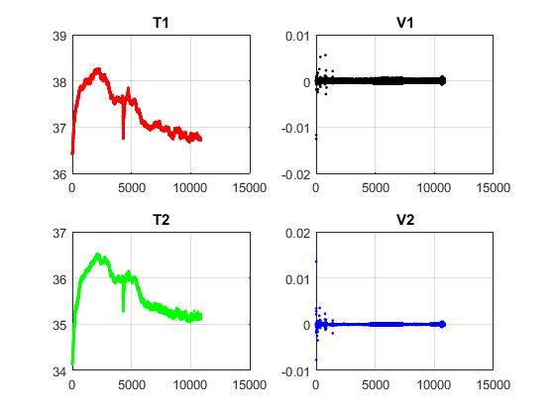
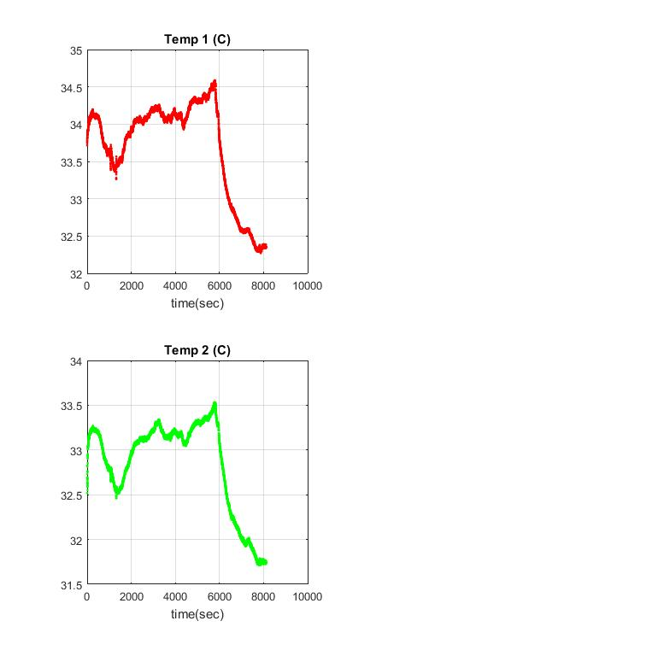
Preliminary Data (early July 2016)
Looped HX, 60°C Inlet, Inlet not submerged
Looped HX, 60°C Inlet, Inlet submerged
HX not looped, 60°C Hot Inlet, Room Temperature Cold Inlet

